Slide 1
Digital Technologies in the Classroom Creating Interactive stories with TWINE
Dr. John McEwan
Institute for Digital Research in the Humanities
john.mcewan@ku.edu
10/23/2024

Slide 2
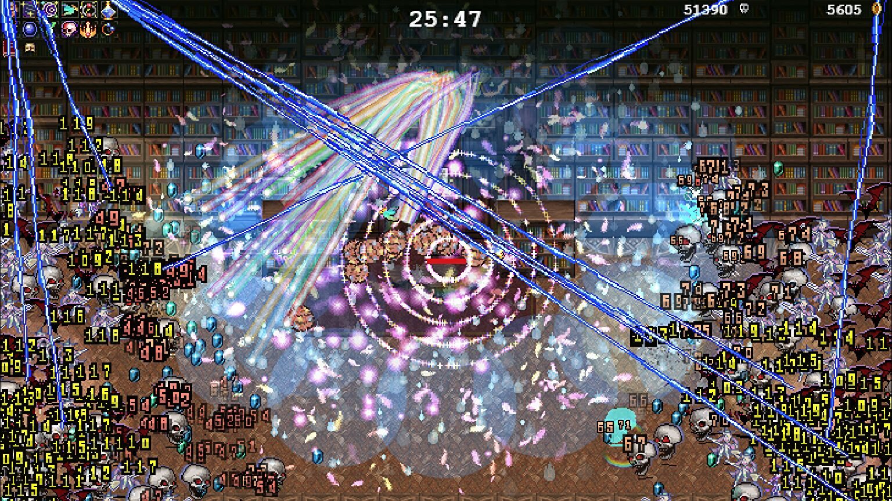
A colourful burst in a Vampire Survivors screenshot.

Slide 3
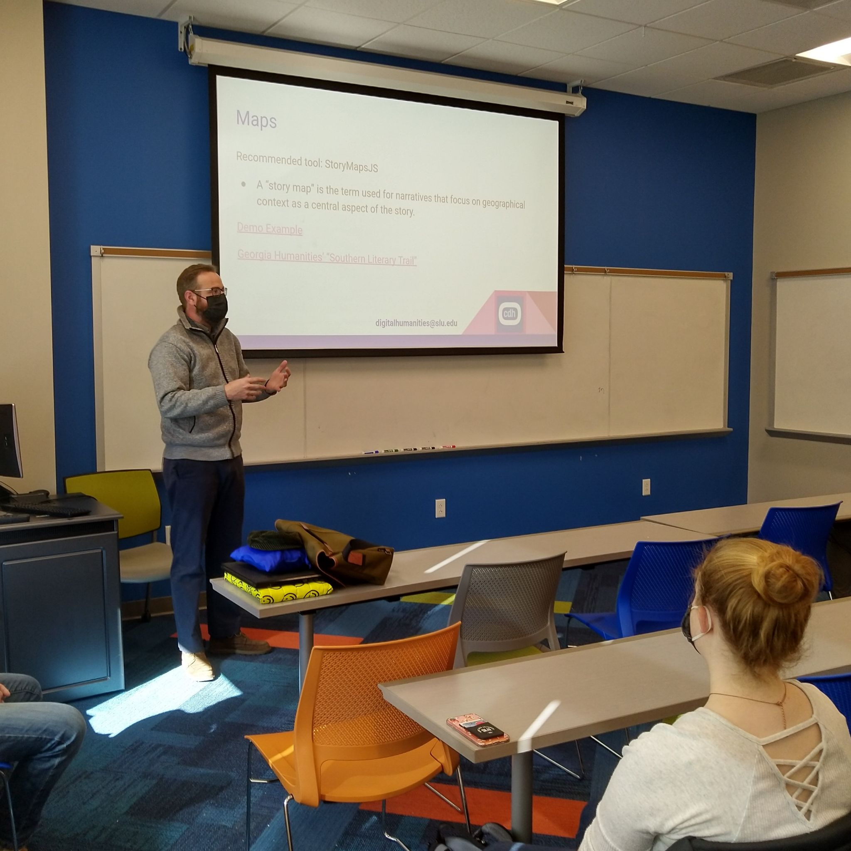
Digital Humanities in the classroom
Introduce students to digital tools and methods for the humanities
Encourage students to think critically about the application of digital tools and methods in humanities research

Slide 4
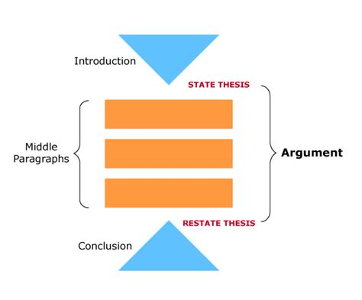
Beyond the essay
In the humanities, we train students to write essays/ articles / books. These forms of expression have conventionalized structures where each component serves a well defined purpose in conveying an argument.

Slide 5
Digital tools can offer alternative methods of making arguments and exploring ideas
Maps/ visualizations
Podcasts
Multimedia websites
Branching narratives

Slide 6
Branching Narratives / Decision Trees
Teach protocols
Investigate problems from multiple perspectives
Present non-linear arguments

Slide 7
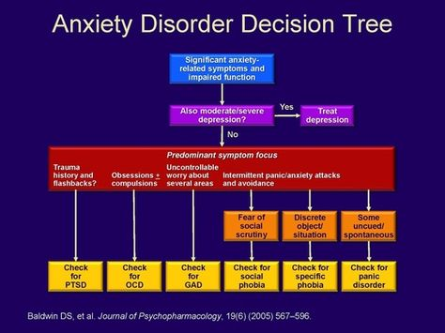
Diagnostic Decision Tree

Slide 8
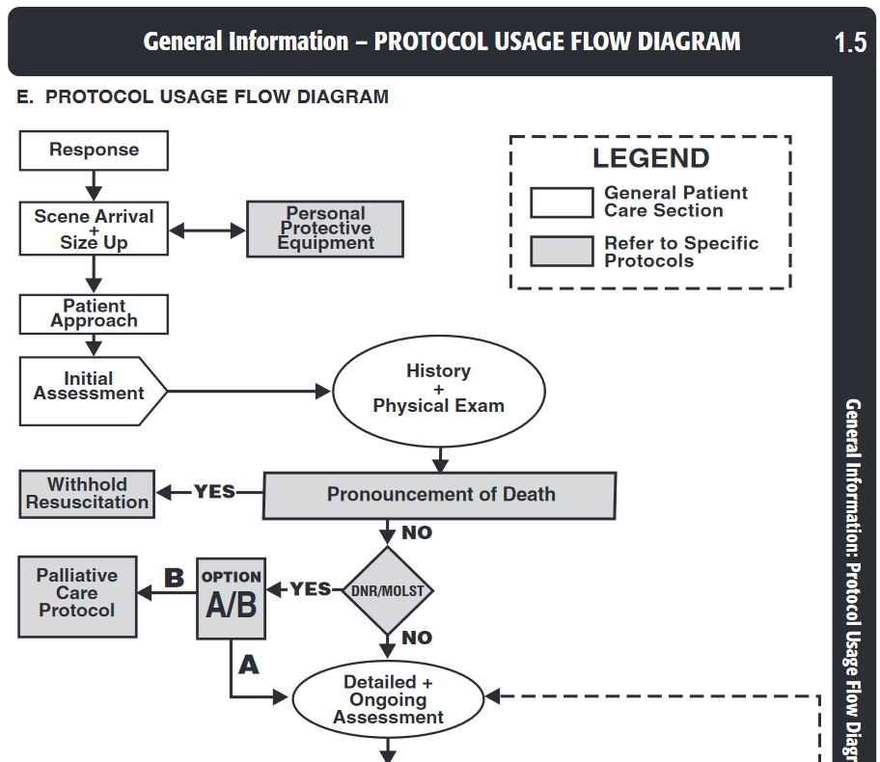
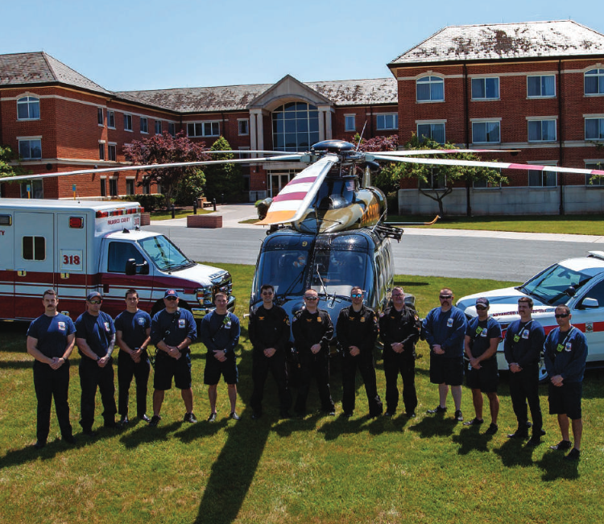
Maryland Medical Protocols for Emergency Medical Services, 2023

Slide 9
History / social policy / interactive fiction
Syrian Journey: Choose your own escape route
The Washington Prison Project
With Those We Love Alive
A few more examples:
A Path of Honors (Jeremiah McCall)
The Hajj Trail

Slide 10
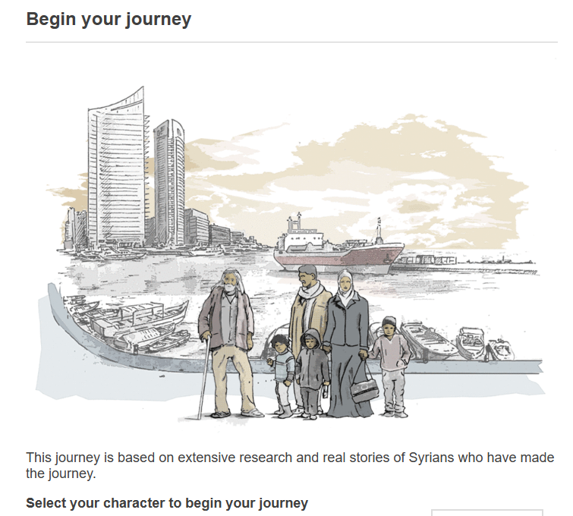
Syrian Journey: Choose your own escape route (2015)
The Syrian conflict has torn the country apart, leaving thousands dead and driving millions to flee their homes. Many seek refuge in neighbouring countries but others pay traffickers to take them to Europe - risking death, capture and deportation.
If you were fleeing Syria for Europe, what choices would you make for you and your family? Take our journey to understand the real dilemmas the refugees face.
The routes, options and outcomes in this Syrian Journey feature were based on real stories uncovered by extensive research as part of a BBC Arabic digital project exploring migration from Syria
https://www.bbc.com/news/world-middle-east-32057601

Slide 11
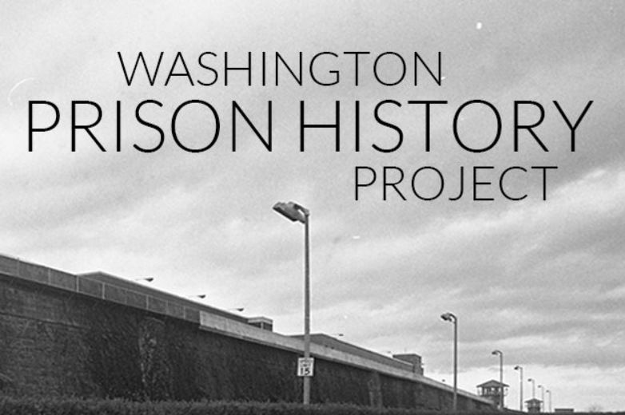
The Washington Prison Project (1987, 2017) Ed Mead, with M. Donea and D. Berger
Who has power in prison and how do they exercise it? The Warden Game provides an unexpected way of thinking about these questions. Rather than a total institution of some predictability, the prison turns out to be susceptible to different forms of activity by incarcerated people, their families and loved ones, journalists, guards, judges, state legislators, and political appointees.
The game contains within it a number of assumptions about the warden’s role and the inherent limitations of the prison as an institution.
https://waprisonhistory.org/wardengame/about/
https://public.imaginingamerica.org/blog/article/a-counter-archive-of-imprisonment-the-washington-prison-history-project/

Slide 12

Purchasing the Dream: Buying a Home in 1960 Chicago
Created and Developed by Jillian Hinegardner
A home in the suburbs is the hallmark of the American Dream. Homeownership became a reality for many people after World War II. The demand for housing increased rapidly as veterans returned from the war and started families. The federal government subsidized the private building industry's efforts to supply the enormous demand.
This simulation is a representation of buying a home in Chicago in 1960. As you interact with the simulation, it is important to remember that this is an interpretation of historical evidence.
The simulation allows you to take on the role of a white family or an African American family. You should take on both roles to get the full experience, but the order does not matter.
https://ehistory.osu.edu/exhibitions/americandream/intro3

Slide 13
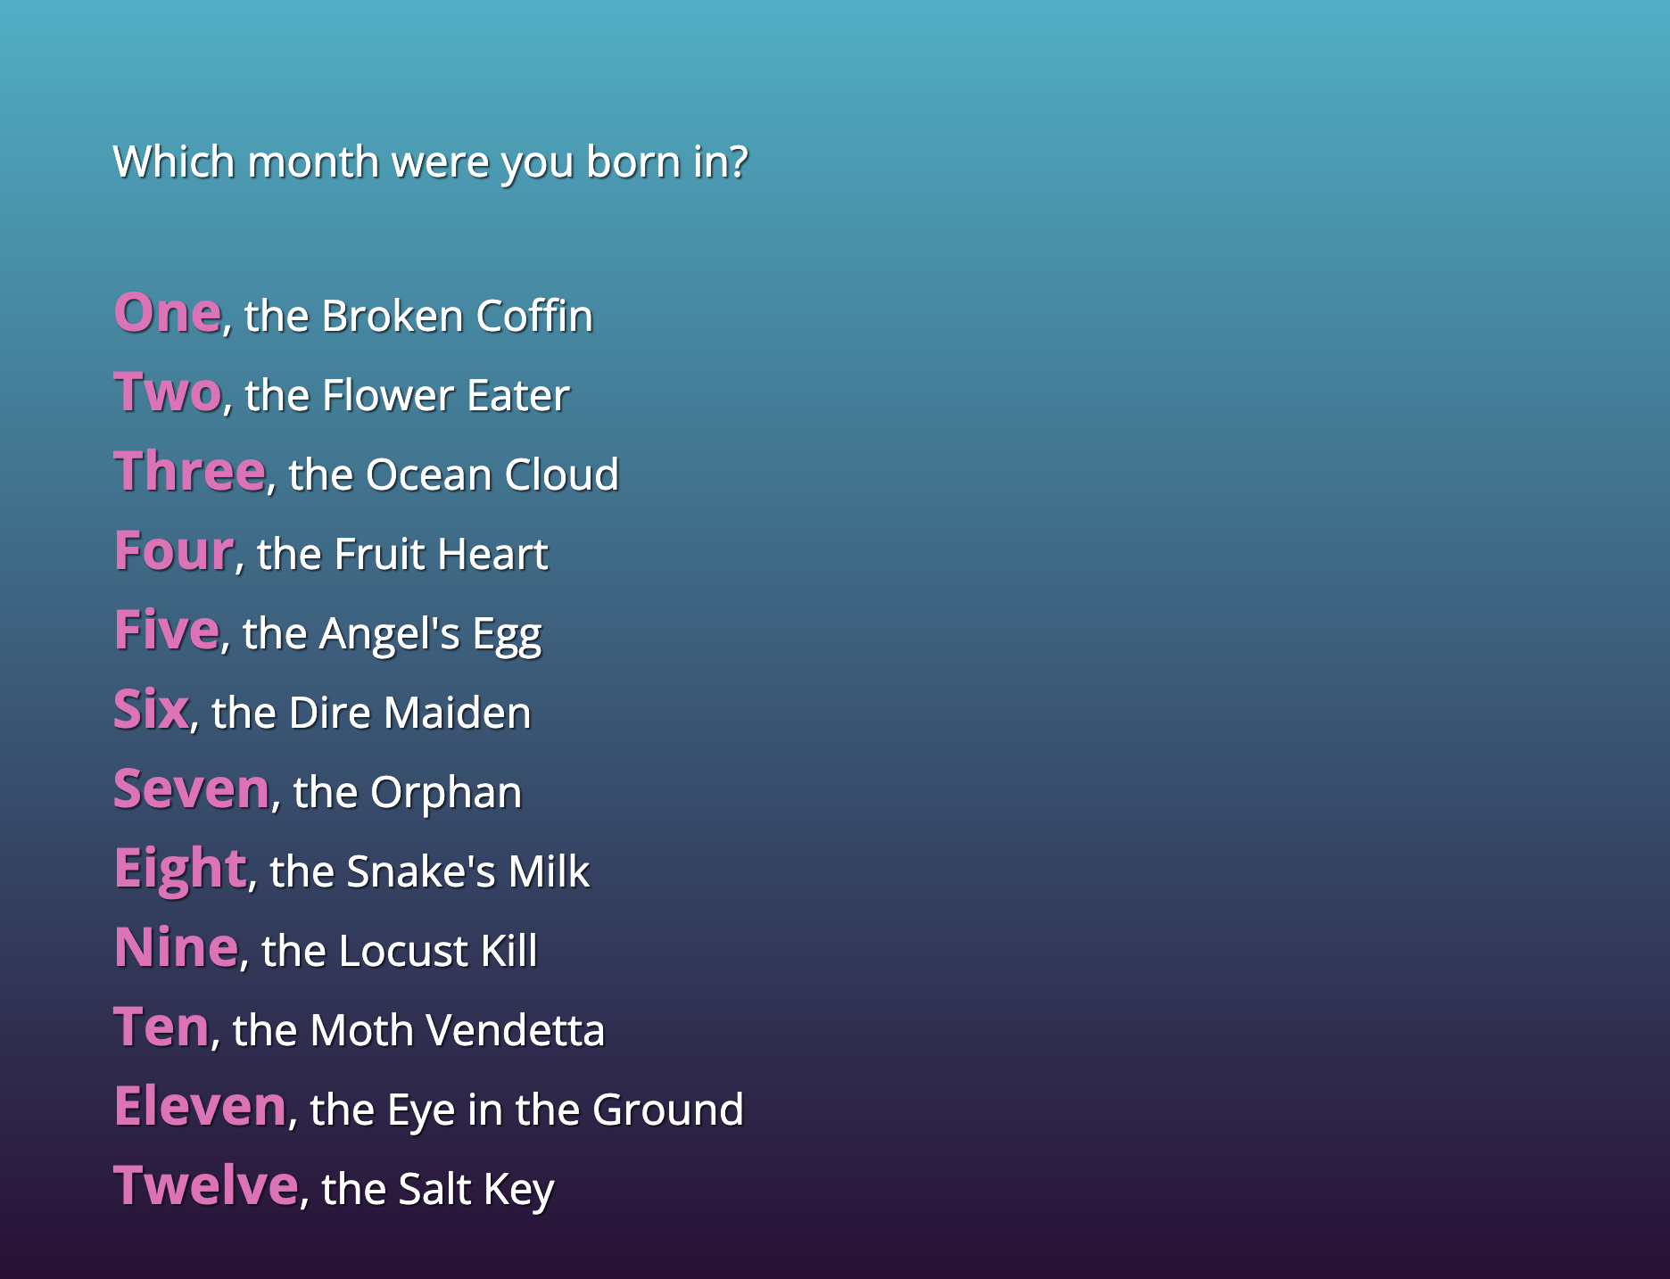
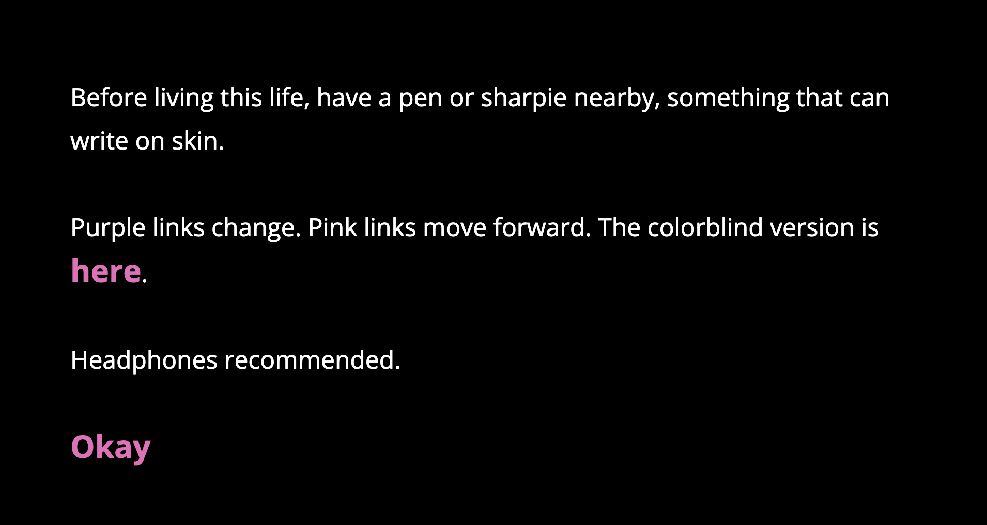
With Those We Love Alive (2014) Porpentine Charity Heartscape https://xrafstar.monster/games/twine/wtwla

Slide 14
Student friendly branching narrative creation tools
Two recommendations:
Twine https://twinery.org/
Ink https://www.inklestudios.com/ink/

Slide 15
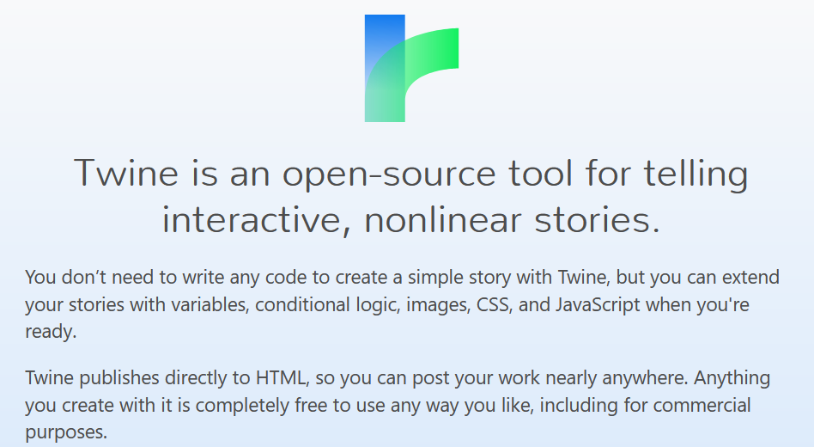
TWINE (https://twinery.org)

Slide 16
Stories
Twine calls the things you make with it stories. But of course Twine can be used to create more than just fiction, or even prose, with Twine. People have used Twine to make:
Nonfiction essays
Role-playing games
Poetry
Visual novels
Procedurally-generated text
Interactive graphic novels
Dialogue trees for games
Complete nonsense

Slide 17
How to get Started
You can use Twine online, but I recommend that you download the program and run it from your own computer. The reason is because Twine saves your work into your browser on your local machine, which is not a secure place to store your data.
Visit https://twinery.org/
The ‘download’ link will take you to Github
Download the appropriate version for your machine
Install

Slide 18
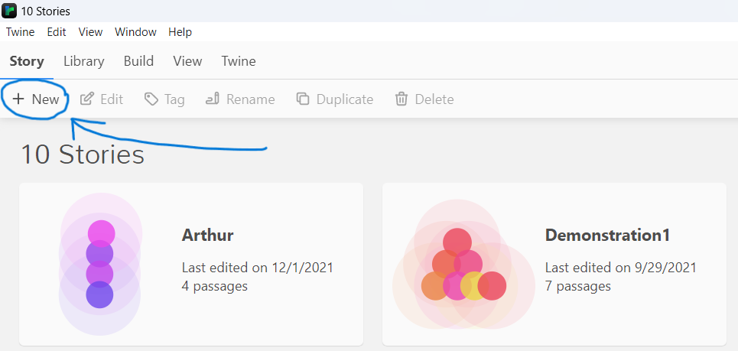
Working with Twine
Click the ‘New’ Button to create a new project

Slide 19
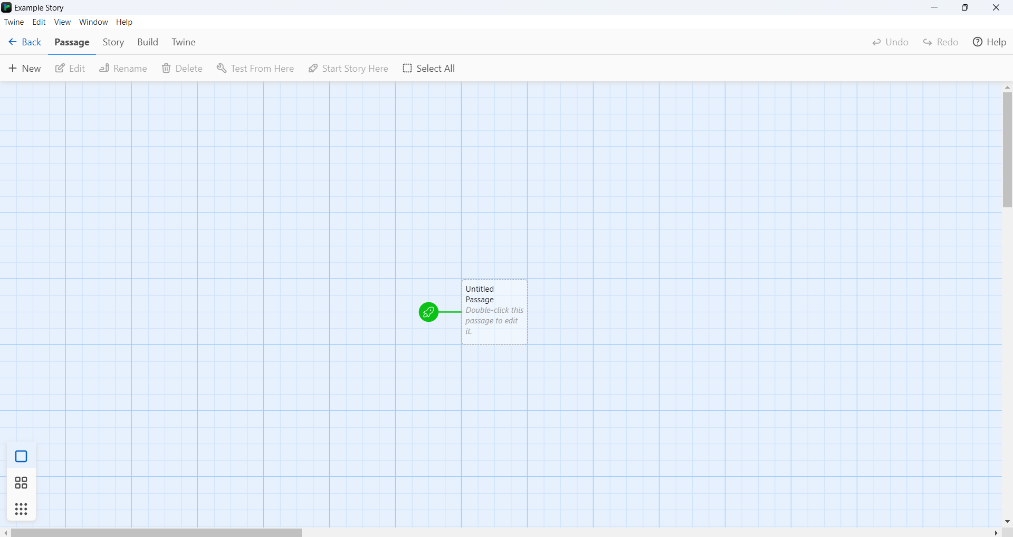
Using the Editor: Passages View
You start with a single square that represents the first ‘page’ of your ‘story’

Slide 20
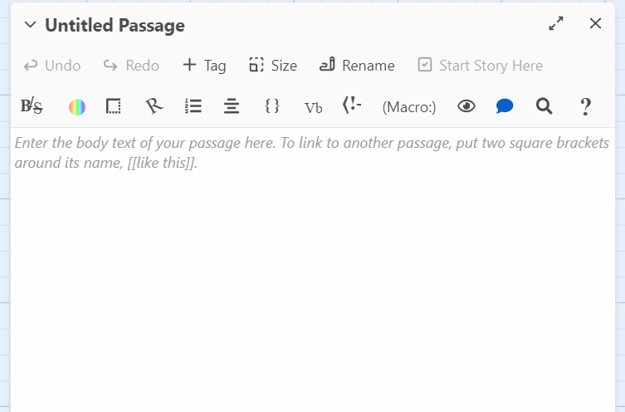
Working with Twine
Click on your ‘page’ to open the editing interface. Here you write what you want the reader to see when they open the page.
Add choices by enclosing them in double square brackets ‘[[Choice 1]]’

Slide 21
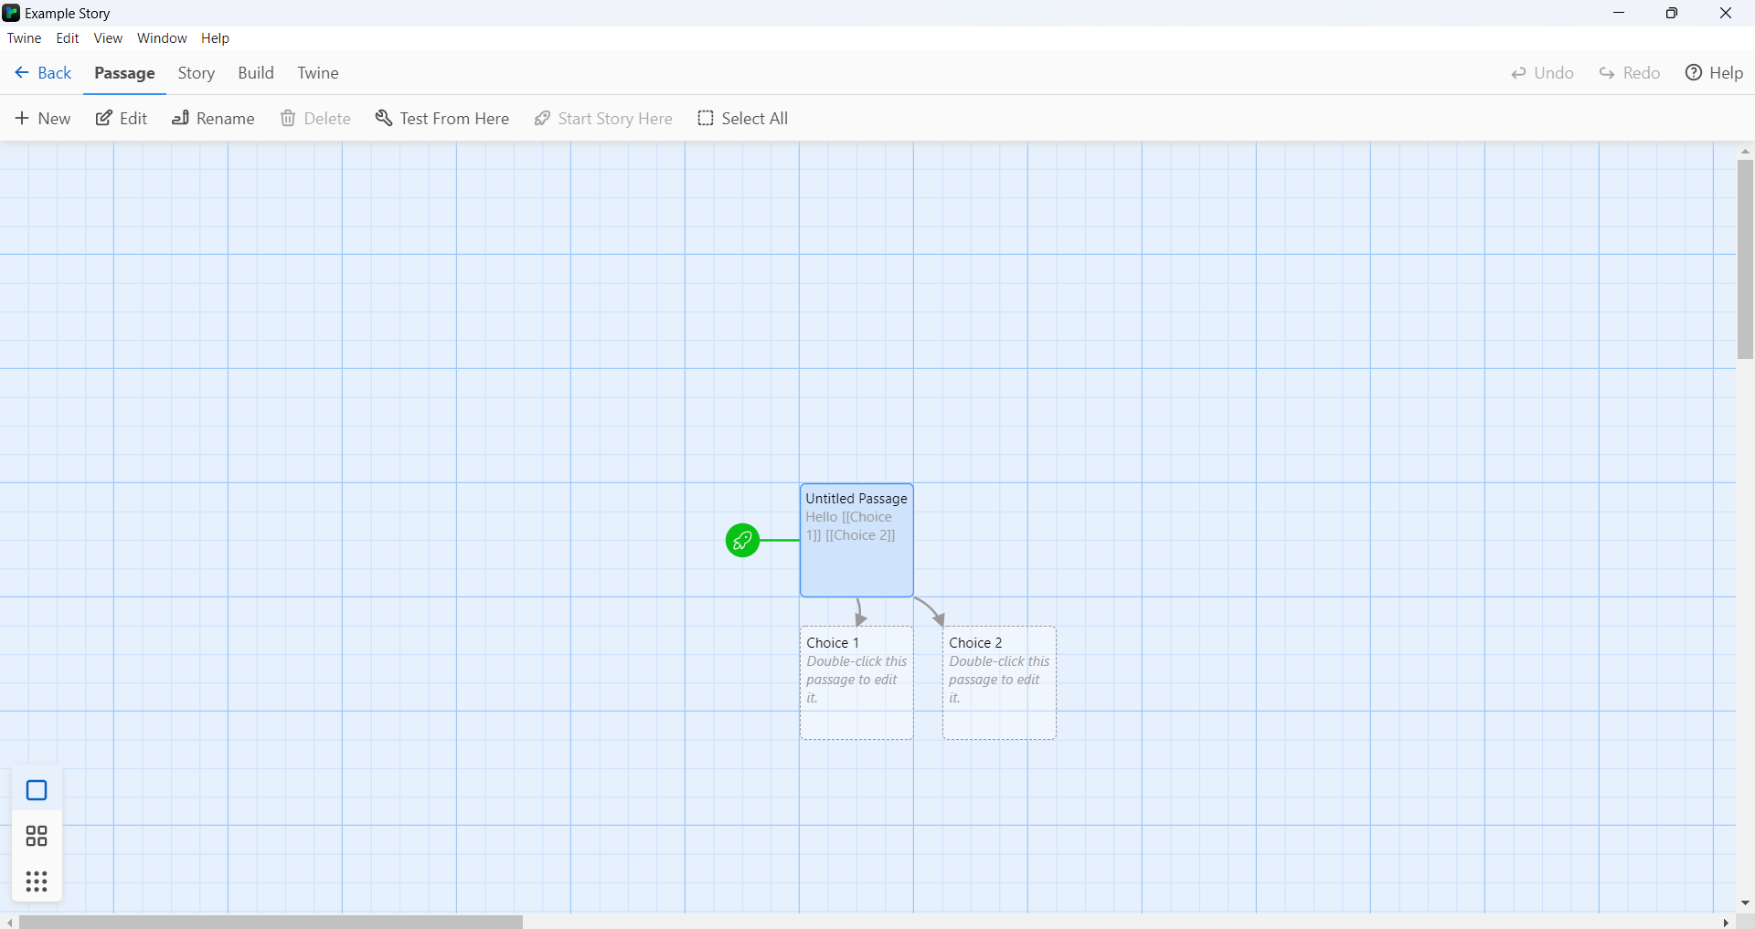
Working with Twine
The computer will automatically create new pages, linked by arrows, to represent the results of each choice.

Slide 22
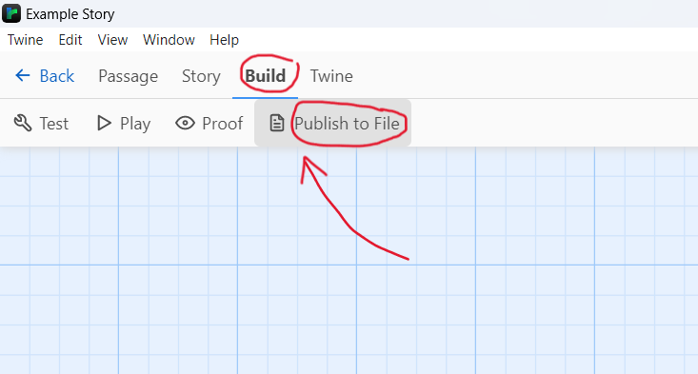
Working with Twine – save your project

Slide 23
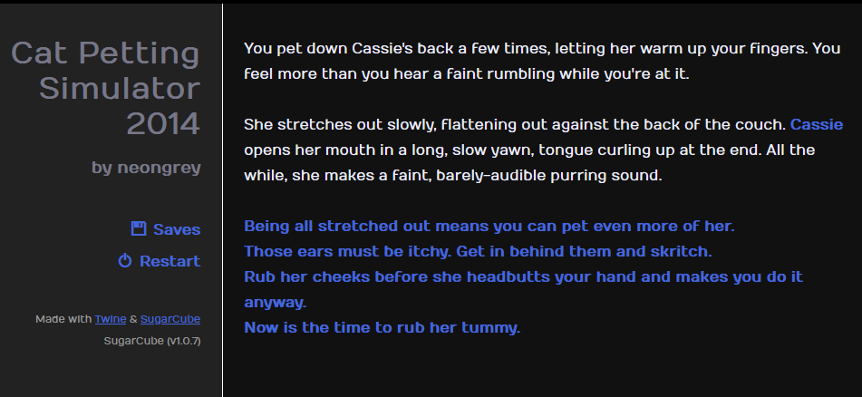
Cat Petting Simulator (2014)

Slide 24
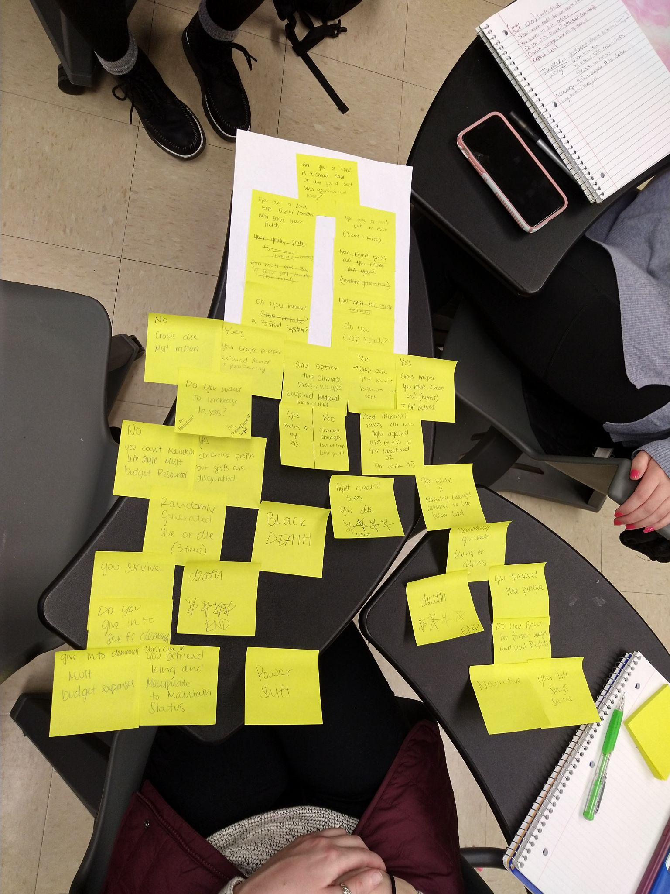
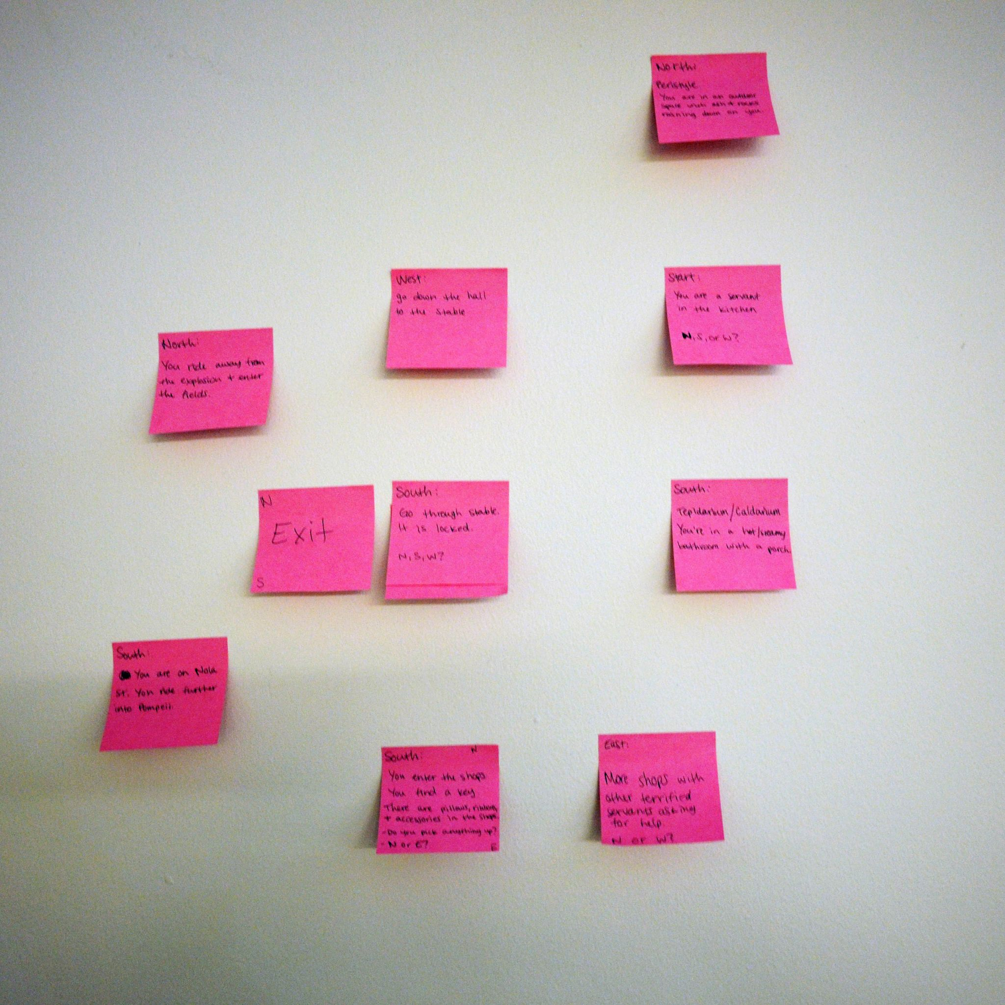
Start with pen and paper

Slide 25
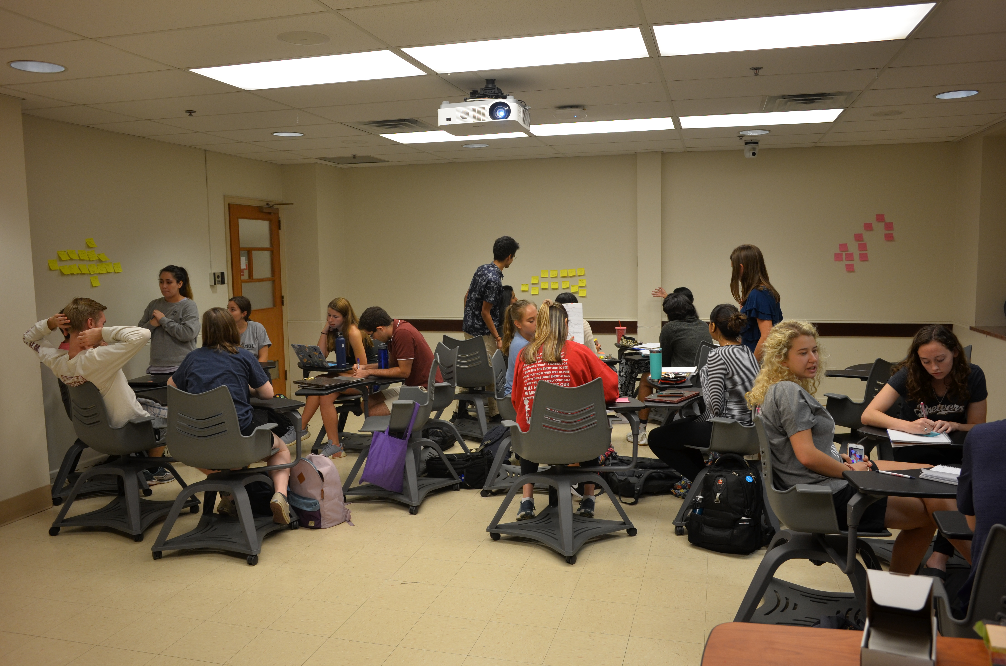
TWINE in the classroom
World History to 1500 (1st year)

Slide 26
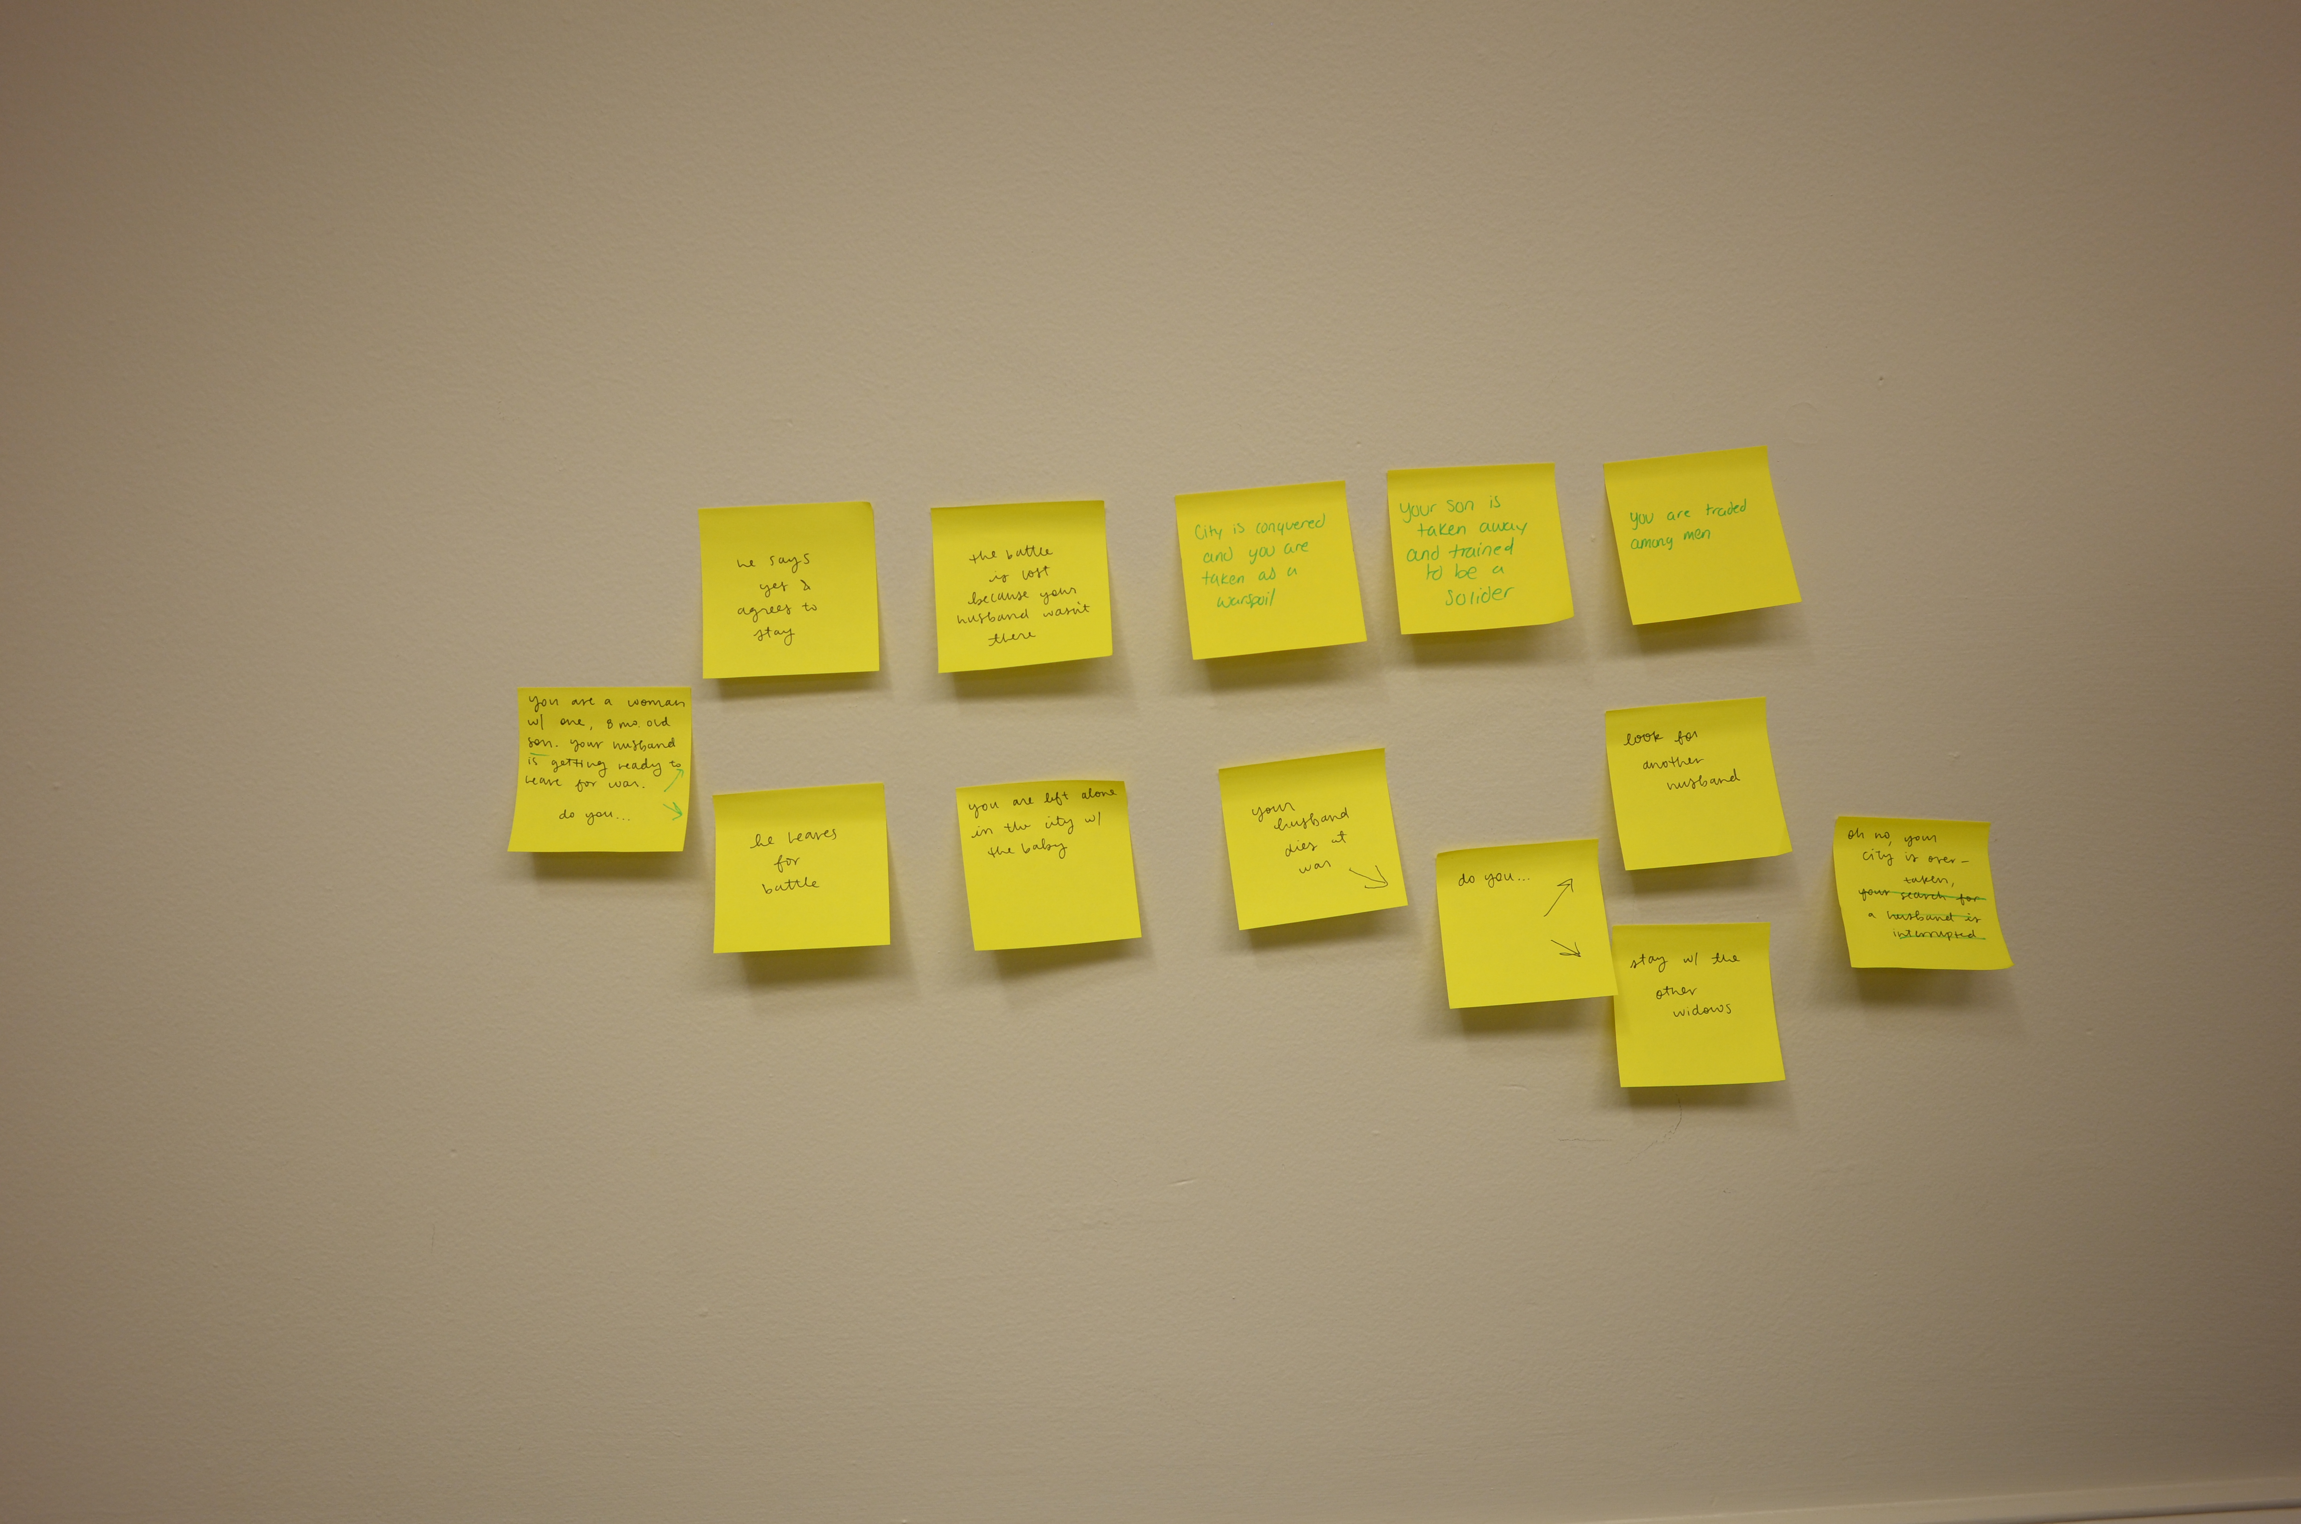
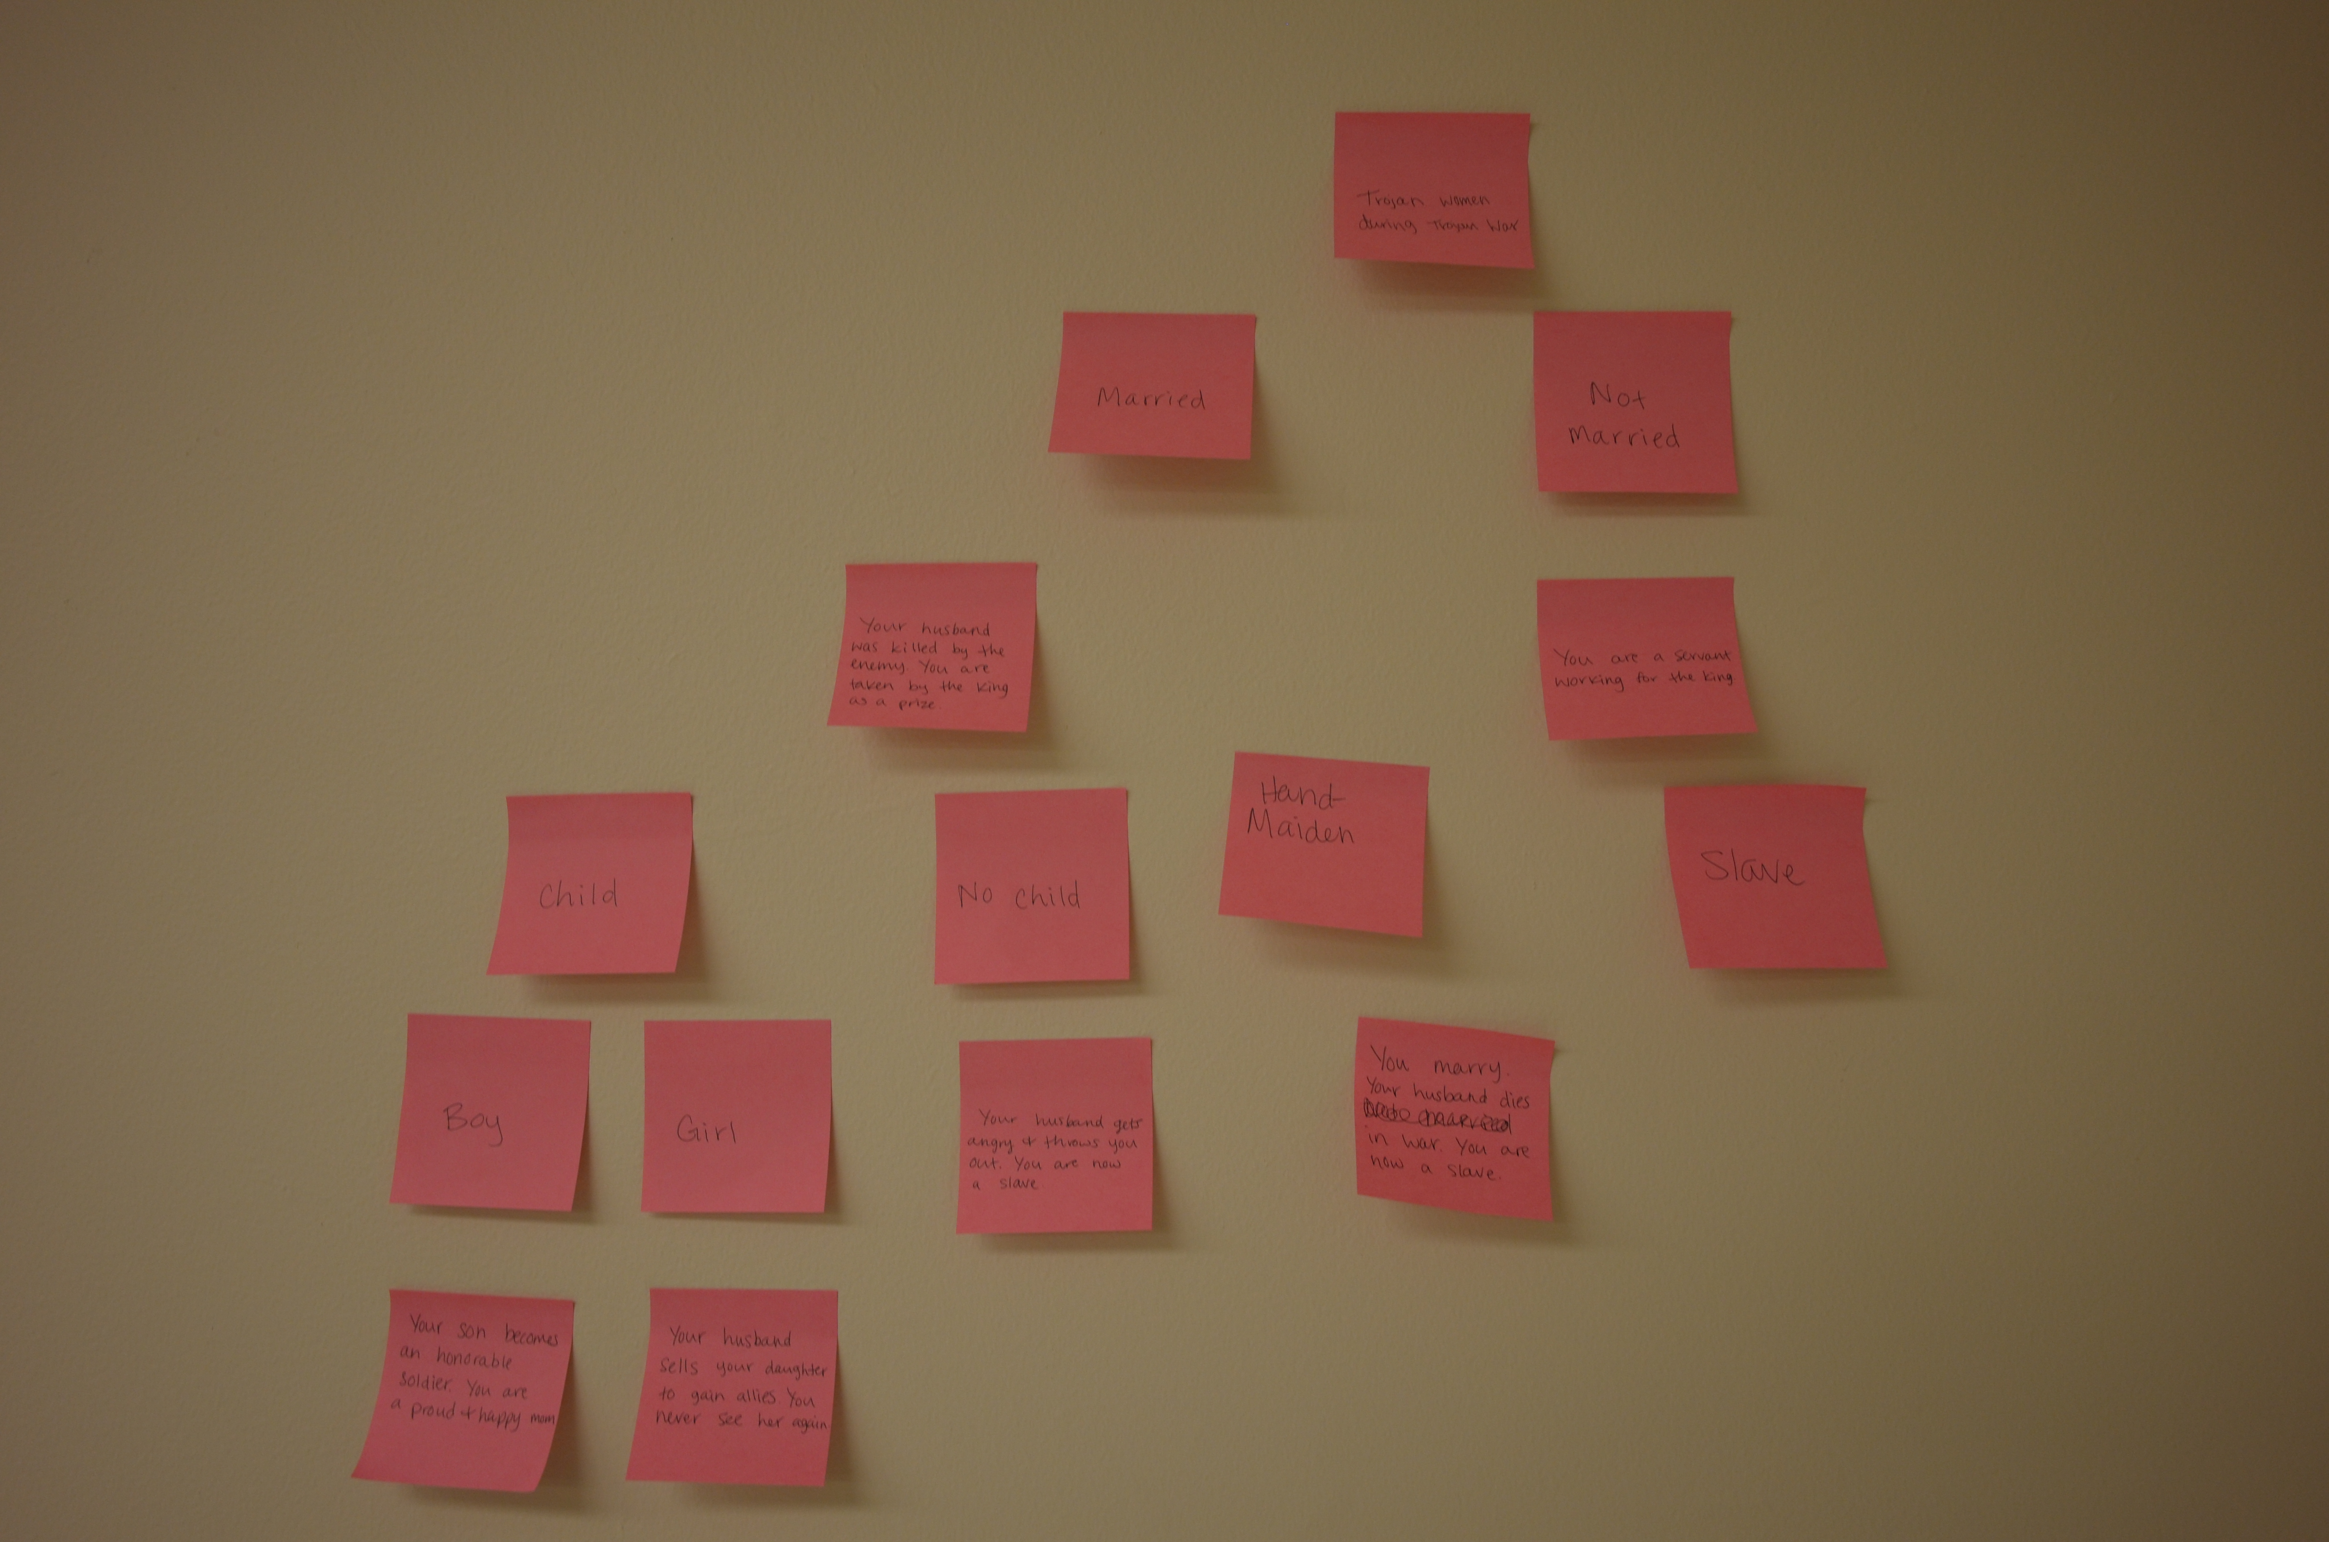
Post-it note exercises

Slide 27
Final Project
This is a group work project.
Drawing on all the course work, including the assigned readings, design and build an interactive game, using TWINE (www.twinery.org). The game’s central character should be fictional, but the narrative should explore genuine historical process. The game, chronologically, may start at any date between 7000 BC to c.1500 AD. The purpose of the game is to impart to your peers (students at a university level) some understanding of the lives of a group of people who lived in the past, so the game must be both engaging and scholarly.
The game should include *all* the following elements:
Preface: A preface of 200 words that outlines and introduces the people who are the subject of the game and the historical questions and processes the game explores and addresses. The preface should include a link to the project bibliography for the project.
Bibliography: A full bibliography of all words cited in the game, together with additional works that provided the intellectual foundation for major features of the game design.
Historical endings: you must have at least three historical endings, each supported by a footnote that directs the player to a particular sources that demonstrates the plausibility of the ending.
Features: your game should demonstrate some technical facility with TWINE and the associated technology for creating website.

Slide 28
Sample projects
https://johnmcewan.github.io/twine_games/1styear_example1.html
https://johnmcewan.github.io/twine_games/1styear_example2.html

Slide 29
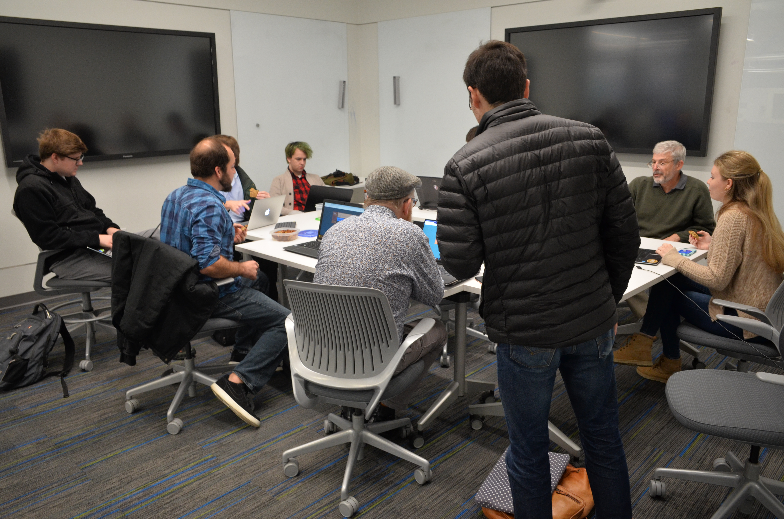
TWINE in the classroom
Digital History (4th Year)
HIST 3930
History in the Digital World
Pius II Memorial Library 402, MWF, 9:00– 9:50 am
Credit Hours: 3

Slide 30
Project Overview
In The Canterbury Tales, Geoffrey Chaucer (c.1343 -1400) offers us a gently satirical portrait of late medieval society. Inspired by this work of fiction, students in HIST 3930 will work on a digital project that will take the form of an educational text-based interactive game, set in London during Chaucer’s lifetime. The central character of each student’s game will be a fictional character (a person who never lived), who will face a series of historically plausible life-defining choices.
To design and build their games, students will employ user-friendly software (www.twinery.org).
The game development process will have several stages.
Students will first develop a proposal for a game (10% of the final grade), prepare a formal research essay that will articulate the empirical and intellectual foundation for their game (30%), build a prototype to present to their peers (25%), and finally prepare a reflective and evaluative statement that sets out the principles underlying its design and considers its audience impact (15%).

Slide 31
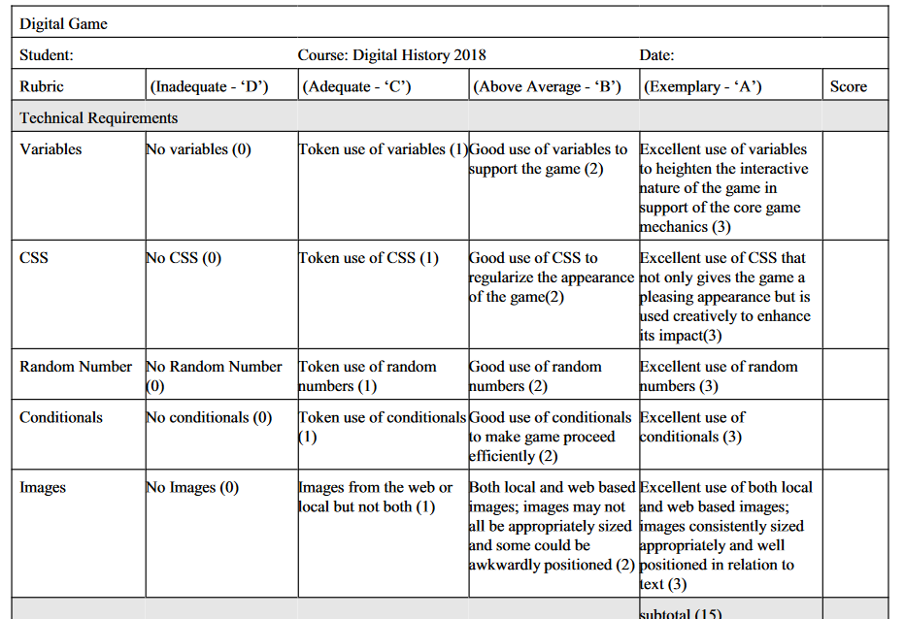
Twine Project Rubric
Twine projects were evaluated using a rubric that took into account several facets of the project
Technical Requirements
Content Requirements
Design (Narrative)
Historical Argument

Slide 32
Sample Projects
https://2018digitalhistory.github.io/2018game/Women%20in%20Medieval%20London_revJM.html

Slide 33
TWINE in the classroom
Introduction to Digital Humanities (Graduate)
Sample projects
Olympics
Benton Barracks

